Slide 1
Module 4 Code Quality
DevOps Academy

Slide 2
Content
Sections
Principles of Code Quality and Lean
Types of quality gate and flow control
Static code analysis overview
Customising Code Analysis
Code Analysis within the CI pipeline
Recommended tools
Intro to lab
Discussion
Summary
References

Slide 3
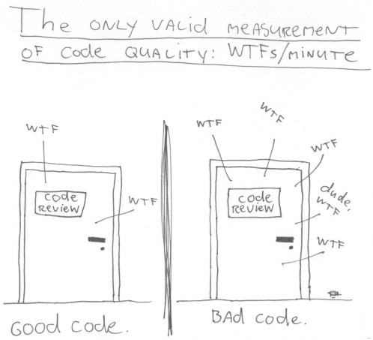
Code Quality
Why do we test?
Utility of the software “fit for purpose”
How well the software is designed and implemented
Standards will be subjective
Typical considerations of owning tests:
Maintenance cost
Technical Debt
More people will read the code than write
Risk e.g. of Financial losses
*
Source: http://www.osnews.com/comics
N.B. WTF = Why The Face
Notes:
Provoke a discussion about why we test and then what are the considerations with owning tests
Discuss the considerations
Maintenance: Bad code will make it difficult to maintain afterwards
- Technical debt: Will have to go back to fix
- More people will read the code than write over lifetime of project: Can’t be a specific style or catered just to advanced need to accommodate all by using best practices
- Financial losses: Can lead to financial losses putting things right

Slide 4
What is testing?
Definitions
Software testing is an investigation conducted to provide stakeholders with information about the quality of the product or service under test.
Software testing can also provide an:
objective,
Independent view of the software
to allow the business to appreciate and understand the risks of software implementation.
Test techniques include, but are not limited to, the process of executing a program or application with the intent of finding software bugs (errors or other defects).
http://en.wikipedia.org/wiki/Software_testing
Notes:
This is the Wikipedia definition, read it or let people read it
Anyone got any criticisms with it??
Emphasis the importance of it being about risk management. You can always cut back on testing, but you increase risk.
Lean focusses on eliminating waste. How could testing be wasteful – class discussion
Testing things that haven’t changed
Finding things later in the lifecycle
Testing things multiple times
Manual testing
Testing too much – could you fix in prod – continuous deployment

Slide 5
What is testing?
Definitions
Software testing is an investigation conducted to provide stakeholders with information about the quality of the product or service under test.
Software testing can also provide an:
objective,
Independent (?) view of the software
to allow the business to appreciate and understand the risks of software implementation.
Test techniques include, but are not limited to, the process of executing a program or application with the intent of finding software bugs (errors or other defects).
http://en.wikipedia.org/wiki/Software_testing
Better Testing Worse Quality? http://testobsessed.com/wp-content/uploads/2011/04/btwq.pdf
“focus on individuals and interactions over processes and tools.” Agile Manifesto
Notes:
This is the Wikipedia definition, read it or let people read it
Anyone got any criticisms with it??
Emphasis the importance of it being about risk management. You can always cut back on testing, but you increase risk.
Lean focusses on eliminating waste. How could testing be wasteful – class discussion
Testing things that haven’t changed
Finding things later in the lifecycle
Testing things multiple times
Manual testing
Testing too much – could you fix in prod – continuous deployment

Slide 6
Dev versus Test
Another silo can exist
Definition
Design
Development
Testing
Operations
Do less testing, someone
else finds the problems
Expert, Centralised
QA Capability
Assumed to own automation
Focus on customer experience and E2E tests
Notes:
Mention how traditionally a divide (similar to Dev versus Ops) often forms between Dev teams and separate testing functions.
Eliminating this key to reducing waste in the delivery lifecycle and speeding it up.
It requires a change of attitude to quality in terms of it being everyone’s problem.
This does often attract certain concerns being raise in regulated environments who may claim to require incompatible segregation of duty in the software lifecycle.
This paper attempts to address this (the DevOps Audit Defence Toolkit):
https://cdn2.hubspot.net/hubfs/228391/Corporate/DevOps_Audit_Defense_Toolkit_v1.0.pdf?t=1453925000299

Slide 7
Different Test Phases
Name the phases
Test types:
UT Unit testing
ST System Testing
SIT System Integration Testing
UAT User Acceptance Testing
TT Technical Testing
OAT Operator Acceptance Testing
FAT Field Acceptance Testing
What are the key principles taken from LEAN?
Notes:
Get the class to define them and propose others.
Ask people to apply lean thinking and what does this guide us about test phases?
Fail fast
Fail meaningful
Eliminate waste

Slide 8
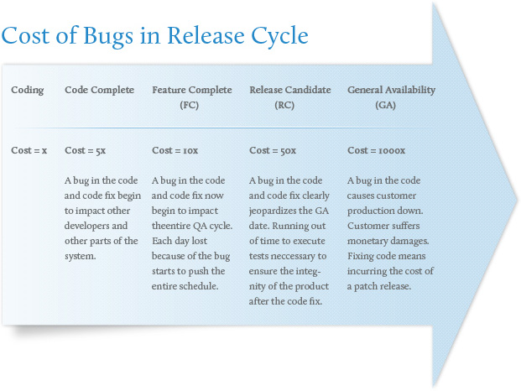
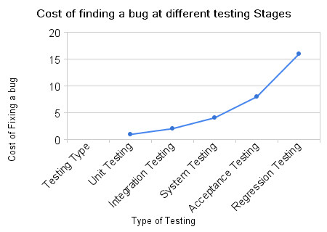
Cost of not Failing (aka Learning) Fast
A lot!
?
http://www.augmentum.com/what-we-do/our-services/software-qa-test
http://www.theautomatedtester.co.uk/blog/2008.htm
Notes:
Get the class to guess the relative cost at each phase
1x = coding
?x = code complete
Etc.

Slide 9
Inverting the Test Automation Pyramid
aka “Shift Left”
What it usually looks like
What it should look like
E2E
E2E / UI
Brittleness of test
Delay before automating
Delay before using
Latest change to use
Complexity
Cost
Service
Service
Unit
Unit
Number of tests
Number of tests
Notes:
To enable: “fast feedback” and eliminate waste, testing needs to be more comprehensive earlier in the lifecycle.
This helps create a more robust, lower maintenance automated test suite.

Slide 10
What is testing?
Is the V-Model all wrong?
SCOPE
USER ACCEPTANCE TEST
HLD
BUSINESS PROCESS
TEST
Scope
Agreement
FUNC. DESIGN
“FAIL”
ASSEMBLY TEST
Design
Review
Test Review
TECH DESIGN
LINK TEST
Design
Review
Test Review
CODE UNIT TEST
Design
Review
Code Review
Notes:
The V-model has waterfall connotations
But doesn’t mean it’s wrong!
It’s a useful tool for working out:
What you are validating at each test phase (look to the left)
How to fail fast (lower on the right of the V fails fastest)
The relative quality of the different left hand phases
What environments you need
It could be one team left to right, so same people on both sides

Slide 11
What about LEAN?
Does drawing it like this make us feel better?
(ALL “DESIGN” STEPS)
DEVELOP UNIT TEST
LINK TEST
ASSEMBLY TEST
BUSINESS PROCESS
TEST
USER ACCEPTANCE TEST
Compile & Package
Committer: jdoe Story:25
Sonar Code Analysis
Commit ID: 113
Create ST env
Deploy Code
Load Test Data
Run Test Harness
Create clustered env
Deploy Code
Run Perf Test
Run Unit Tests
Tear down ST env
Run Security Test
Prod deploy
Value Stream Mapping
Run Ops Test
Processing time
Waiting time
Notes:
Drawing the V-model to look more like a pipeline
They aren’t so different
Still want to fail fast
We just have to think about the value of every step and wastage.
Short intro to value stream mapping

Slide 12
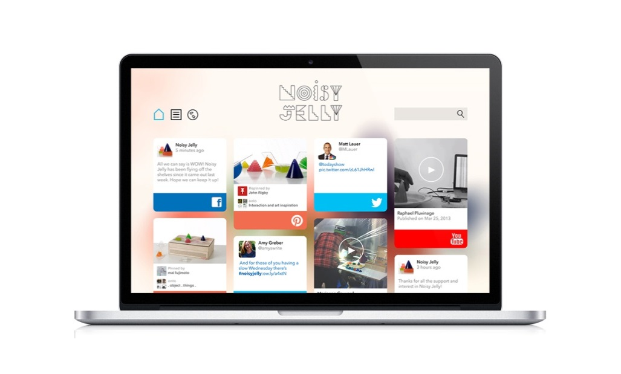
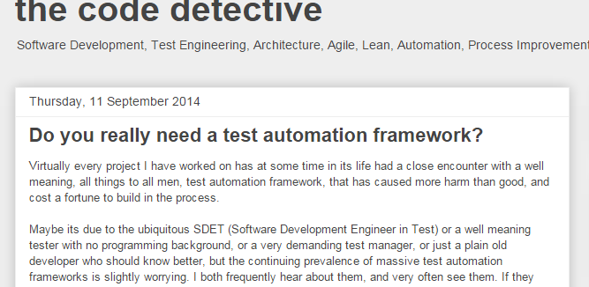
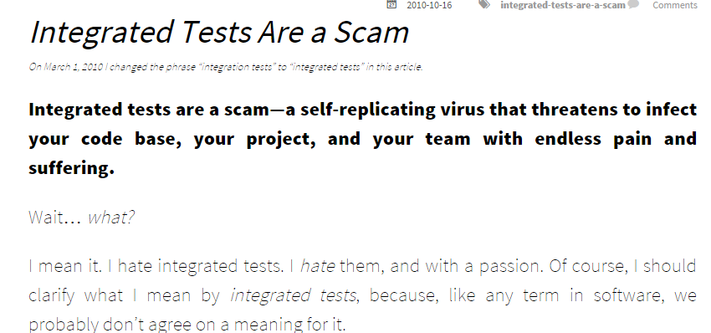
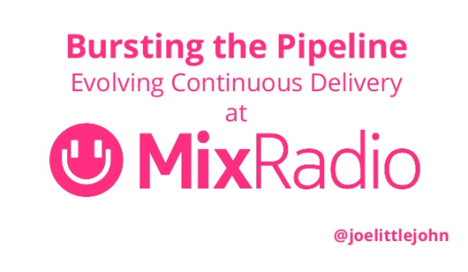
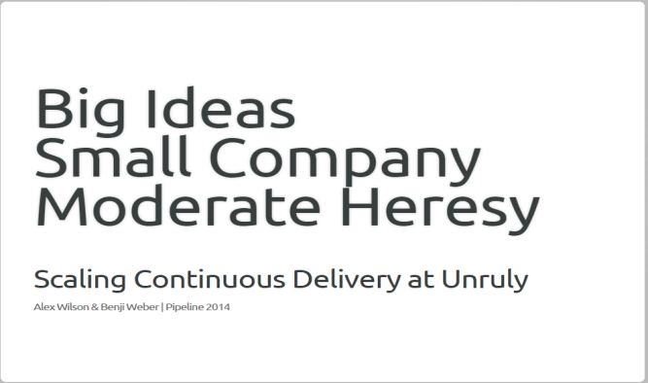
What about LEAN?
To “healthy” extremes
http://codedetective.blogspot.co.uk/2014/09/do-you-really-need-test-frameworks.html
http://blog.thecodewhisperer.com/2010/10/16/integrated-tests-are-a-scam/
http://www.slideshare.net/joelittlejohn/bursting-the-pipeline-evolving-continuous-delivery-at-mixradio
http://benjiweber.co.uk/talks/pipeline/#/
Notes:
These presentations talk about really iterating on improving pipelines
The balance of Risk versus Risk Mitigation (Testing) is heavily refined
Which can lead to conclusions like the headlines on these blogs
And nice presentations like these where they’ve taken almost all of the steps “out of the pipeline”

Slide 13

WHAT DOES THIS MEAN FOR PEOPLE?
Notes:
Some suggestions:
Git means less admin work (cf ClearCase!)
Developers to train

Slide 14

Types of Quality Gate

Slide 15

Quality Gates
Flow control using Code Quality
Quality gates are a set of conditions that determine whether your project build passes or fails.
These are used as checkpoints to assess whether the projects code quality is good enough to continue in the build and deploy process or the code quality needs to be improved
Types of Quality gates that can go into a pipeline:
Static
Unit test
Functional
Non-functional
Canary testing
Copyright © 2016 Accenture All rights reserved.
Notes:
Presenter Notes:
Expand on the different types of quality gates
Mention they correspond to boxes on the right of the V-model and the traditional test phases we’ve covered

Slide 16
Quality Gates in the CI Pipeline
Features through out the pipeline
Immediately after code committed to SCM
If the quality is insufficient, we want to fail as fast as possible (in a helpful meaningful way)
Static: Before the deployment
Dynamic: After
Static
Dynamic
Immediate start after check-in. One new change per new pipeline
All stages e.g. code analysis used as enforceable gates
Compile & Package
Deployment
Committer: jdoe Story:25
Sonar Code Analysis
Commit ID: 113
Create ST env
Deploy Code
Load Test Data
Run Test Harness
Create clustered env
Deploy Code
Run Perf Test
Parallel execution
Run Unit Tests
Tear down ST env
Run Security Test
Prod deploy
Run Ops Test
Copyright © 2016 Accenture All rights reserved.
Notes:
We’ve covered where they go - throughout
Failing fast is important as is (from CI)
Key point is “Stop the production line”. Analogous to a factory stopping. Machines being powered down. Relative calm and quiet.
People rally together to fix the failing machine / test.
And then re-start
Finally we can class the tests as Static – no dependencies e.g. DB, environment, network
Dynamic – dependencies and run in a test environment

Slide 17
In terms of the V Model
All stages on the right
SCOPE
USER ACCEPTANCE TEST
HLD
BUSINESS PROCESS
TEST
Scope
Agreement
DYNAMIC
FUNC. DESIGN
ASSEMBLY TEST
Design
Review
Test Review
TECH DESIGN
LINK TEST
Design
Review
Test Review
CODE UNIT TEST
Design
Review
Code Review
STATIC
Notes:
All stages on the right
Once you’ve deployed you can do dynamic tests.

Slide 18

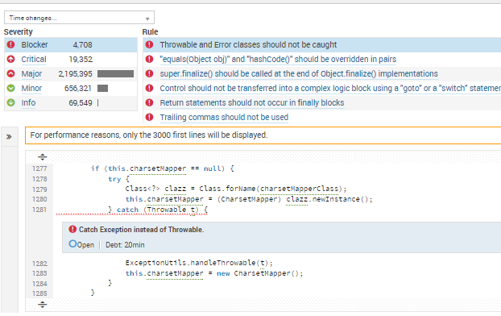
Static Code Analysis
Overview of steps in Static Code Analysis
Static Code Analysis Tool
Reads through the source code:
Checks code violations against a defined rule set
Provides statistics based on code
Lines of Code
Comments (%)
Hotspot / Quality
Plugins usually available
http://nemo.sonarqube.org/drilldown/issues/219971?rids%5B%5D=219996&rule=squid%3AS1181&rule_sev=BLOCKER&severity=BLOCKER
Copyright © 2016 Accenture All rights reserved.
Notes:
Basically it’s like the syntax stage of a compiler but much stricter
If a compiler syntax checking is a spell check, this is a super grammar checker
This is a screenshot from Sonar – a tool we like
It’s actually a public instance
And this is a real issue with… TomCat!

Slide 19
Source Code Quality
Seven axes of source code quality
….
Sources
Comments
Architecture and Design
Coding rules
Duplications
Potential Bugs
Unit tests
Complexity
http://docs.codehaus.org/display/SONAR/Developers%27+Seven+Deadly+Sins
Copyright © 2016 Accenture All rights reserved.
Notes:
SonarQube is a popular tool and defines these 7 axes of how to look at the quality of the code.
- Comments: Little or too many comments
- A&D: Spaghetti design
- Duplication: remove duplicates
- Unit test: Lack of sufficient testing
- Complexity: bad distribution of complexity
- Potential bugs: Discover them early
- Coding rules: Check code is written according to accepted standard and best practices

Slide 20
Unit Tests
Overview of unit tests
Generally written:
Per Class
Per method
Per code permutation
Don’t require dependencies:
Database
Filesystem
Network
Middleware e.g. Tomcat
We can measure all aspects:
Pass/fail
Coverage
public class Subscription { private int price ; // subscription total price in euro-cent private int length ; // length of subscription in months // constructor : public Subscription(int p, int n) { price = p ; length = n ; } /** * Calculate the monthly subscription price in euro, * rounded up to the nearest cent. */ public double pricePerMonth() { double r = (double) price / (double) length ; return r ; } }
import org.junit.* ; import static org.junit.Assert.* ; public class SubscriptionTest { @Test public void test_returnEuro() { System.out.println("Test if pricePerMonth returns Euro...") ; Subscription S = new Subscription(200,2) ; assertTrue(S.pricePerMonth() == 1.0) ; } @Test public void test_roundUp() { System.out.println("Test if pricePerMonth rounds up correctly...") ; Subscription S = new Subscription(200,3) ; assertTrue(S.pricePerMonth() == 0.67) ; } }
Code
Test
Copyright © 2016 Accenture All rights reserved.
Notes:
Read the 3 main points
Walk through this example
One file <name>Test for our <name> file
We create an instance
We run different scenarios
We asser

Slide 21
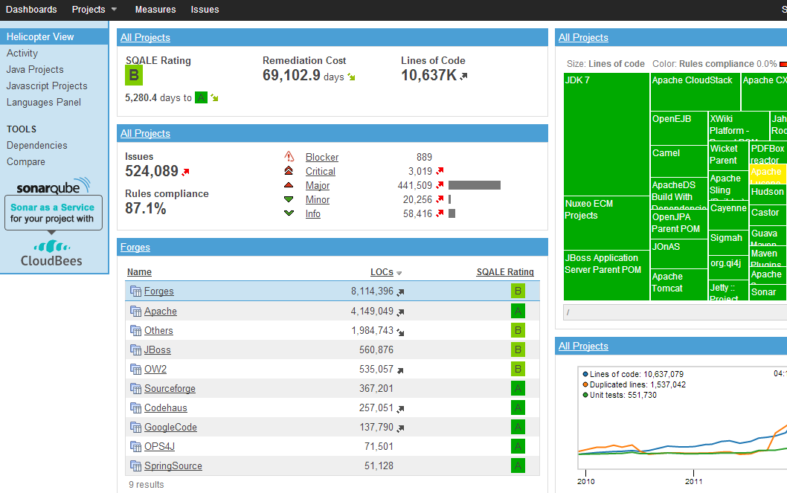
Customising Code Analysis
Tailoring Code Analysis to your project
Not every single project is the same
Analysis can be adjusted based on the project
Code Analysis can be tailored to all the major languages
Copyright © 2016 Accenture All rights reserved.
Notes:
This a screenshot of SonarQube
Key things to get right for a project:
Plugins – right for your code type
Rules – which to test and how severe
Thresholds to fail the build
this IS a quality gate

Slide 22
Other Tools for Static Code Analysis
Various options
SonarQube
CSS Lint
Total Validator
FX Cop
Food Critic
Perl Critic
RuboCop
Rational AppScan
Copyright © 2016 Accenture All rights reserved.
Notes:
Have a discussion about who has used what
Stress, we like SonarQube – it’s very powerful out of the box, extensible, part of Monsoon, etc.
Can anyone spot the half jokey one? The Rational AppScan isn’t one we actually use.
There are commercial options here… but FOSS is great!

Slide 23
Slower More Complex Testing
Moving up “V” model
SCOPE
USER ACCEPTANCE TEST
HLD
BUSINESS PROCESS
TEST
Scope
Agreement
DYNAMIC
FUNC. DESIGN
ASSEMBLY TEST
Design
Review
Test Review
TECH DESIGN
LINK TEST
Design
Review
Test Review
CODE UNIT TEST
Design
Review
Code Review
STATIC
Notes:
Moving up the of the V – tests on the right
The key difference is that these tests require dependencies.

Slide 24
Behaviour Driven Development (BDD)
Testable Requirements
Built on the concept of Test Driven Development (TDD)
Invented by Dan North http://dannorth.net/introducing-bdd/
Expected behaviour is expressed in plain text
User story statements are hard to test:
User story: "As a [role] I want [feature] so that [benefit]“
BDD statements are testable and become a documented specification of how your application should behave:
BDD definition: “Given [initial context], when [event occurs], then [ensure some outcomes]”
Copyright © 2016 Accenture All rights reserved.
Notes:
Reminder: TDD: Test Driven Development
Developer write tests to test their own code Tests are usually “unit tests”, i.e. they work on units of code in isolation with no dependencies
Test First Development means the tests are written before the code as opposed to at the same time
Allow the developer to validate that their code works as they expected
Allows someone performing refactoring to validate that the code still works as it was previously expected to
BDD: Behaviour Driven Development
Invented by Dan North and an extension of TDD http://dannorth.net/introducing-bdd/
Tests are derived from functional requirements
Tests are usually more complicated than unit tests and require the code to have been deployed
The link from requirements to tests can be managed by a tool like Cucumber
User story: "As a [role] I want [feature] so that [benefit]“
Given [initial context], when [event occurs], then [ensure some outcomes]
Experience in the room? Limitations?

Slide 25

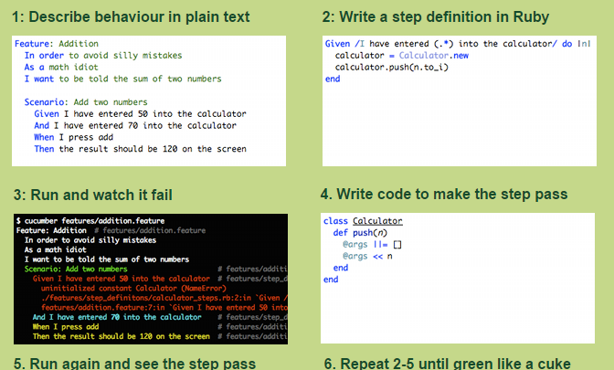
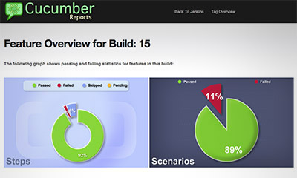
Cucumber
“Until your code is green like a cuke”
Copyright © 2016 Accenture All rights reserved.
Notes:
This slide explains it
Here is a pretty output from Jenkins
Cucumber lets you write features in natural language and develop them behaviour-driven afterwards
It is a tool that executes plain-text functional descriptions as automated tests.
Written in Ruby but can be used in other programming languages
Cucumber-JVM for Java
IronRuby and .NET for .NET
cucumberl for Erlang
Gherkin is the language that Cucumber understands
It is a Business Readable, Domain Specific Language
It lets you describe software’s behaviour without detailing how that behaviour is implemented.
Cucumber logo credit: https://github.com/cucumber/cucumber/wiki

Slide 26
Alternatives
Alternatives to Cucumber
FitNesse
easyb
JDave
Concordion
jbehave
Copyright © 2016 Accenture All rights reserved.
Notes:
Any experiences?
Any down sides?
Risks?
Expensive
More metadata about bad tests
Even more complicated

Slide 27
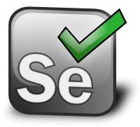



Automated Functional Testing - Selenium
Functional testing with Selenium automates browsers
Functional testing is testing of the application’s user interface that determines how the application and the user interact and whether the application performs properly.
Usually we ant to parallelise this as much as possible using a grid
Test Series of selenium commands
Sent to
Selenium Grid (A java-based command line server)
Coordinates several Selenium RC servers to execute multiple tests on different browsers and platforms concurrently
Selenium Remote Control 1 (A java-based command line server)
Starts up browsers one-at-a-time and then runs the tests
Selenium Remote Control 2 (A java-based command line server)
Starts up browsers one-at-a-time and then runs the tests
https://www.varnish-software.com/blog/selenium-grid-parallel-automation-testing-varnish-administration-console
Copyright © 2016 Accenture All rights reserved.
Notes:
Talk about Selenium being just one way to automate tests
Mention needing a grid and a virtual screen (frame) buffer e.g. XVFB

Slide 28

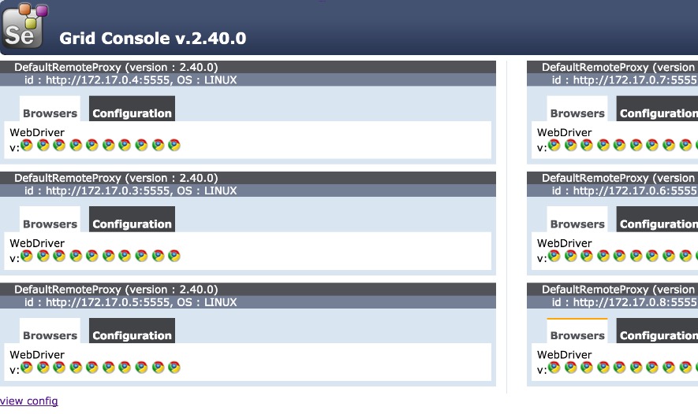
Automated Functional Testing - Selenium
Selenium Hub/Grid View
Copyright © 2016 Accenture All rights reserved.
Notes:
Explain Grid view.
Nodes – nodes have one or more webdrivers.
Hub – has 0 or more nodes registered.

Slide 29

Automated Security Testing – OWASP Zed Attack Proxy (ZAP)
Security Integration Testing with Selenium
Free open source penetration security tool for vulnerability discovery.
Scans HTTP Requests/Responses against the Common Vulnerabilities and Exposures (CVE) database
SQL Injections
Cross-site scripting attacks
Information disclosure (session IDs etc)
Route your Selenium functional tests through the intercepting proxy.
Generate XML/HTML Vulnerability reports.
Copyright © 2016 Accenture All rights reserved.
Notes:
Slide sums up OWASP ZAP and shows vulnerability report.
Experiences: Proxying traffic increases Selenium execution times.

Slide 30
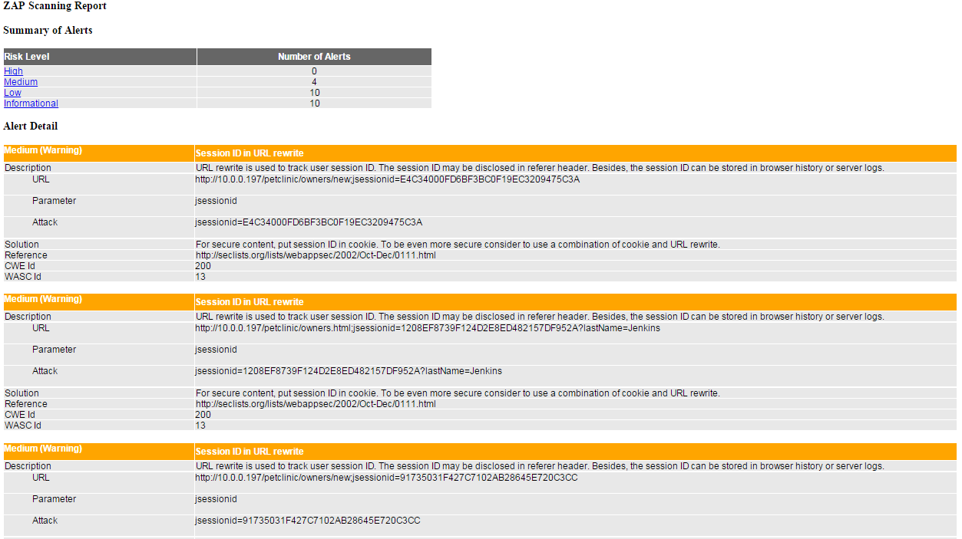
Automated Security Testing – OWASP Zed Attack Proxy (ZAP)
Security Testing - Example ZAP Report
Copyright © 2016 Accenture All rights reserved.
Notes:
Slide sums up OWASP ZAP and shows vulnerability report.
Experiences: Proxying traffic increases Selenium execution times.

Slide 31
Alternatives
Lots of alternatives
Rational Robot
Casper.js
HP
Se
Watir
Autoit
Sauce Labs
SOASTA
Copyright © 2016 Accenture All rights reserved.
Notes:
Discuss experiences and pro’s and con’s
Sauce Labs and Soasta are worth mentioning as SaaS options – great options, but hard for Accenture to use as we’re putting client data into someone else’s cloud

Slide 32
Isolation
Introduction to Stubbing
Software may include an integration of a great number of different dependent systems / components.
When developing an update to a system, it will be necessary to regression test interactions with dependent systems
Booking website
Payments System
System under development
ERP System
Integrated dependent system
Fraud system
Enterprise Service Bus
Underlying dependent system
Billing System
Direct integration to test
Dependent integration
Possible challenges :
costs associating with creating a test instance (e.g. for hosting, or for paying a third party)
complexity of hosting e.g. due the requirement for all of the underlying systems
the need for specific test data
stability e.g. the dependent system may not yet be written
Stubbing is the process of writing a substitute piece of software to imitate the dependent system
Booking website
Payments System
Stub
ESB
Emulated integration
Fraud System
Copyright © 2016 Accenture All rights reserved.
Notes:
Get someone to define

Slide 33
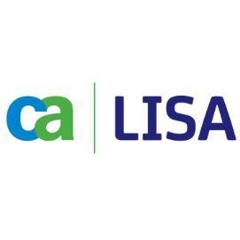


Service Virtualisation
Someone invented a commercial product for that
A commercial Service Virtualisation tool provides an automated alternative to manually writing stubs to emulate other systems when writing software.
The majority of the benefits for using Service Virtualisation are an exact match of the benefits of using stubs.
The main added benefits of Service Virtualisation are a result of the ease of stub creation/recreation:
A reduction in operational costs related to creating stubs
Greater adoption of stubs and hence realisation of more of the associated benefits
In addition, some Service Virtualisation tools can be used to act like a test harness and exercise your system.
The decision to adopt a Service Virtualisation tool requires a cost benefit analysis of the following alternatives:
Make available more tests instances of other systems (thus removing the need for emulation)
Manually create stubs
Purchasing and adopting a Service Virtualisation tool
The better you are at creating test instances of other systems (with data), they less you may need stubs.
The more formally contract-drive you components (APIs) are, the less integrated testing needed.
Copyright © 2016 Accenture All rights reserved.
Notes:
Be somewhat constructive about SV tools, but recognise that they don’t add that much more than stubs

Slide 34
Further Reducing The Risk of Releasing
What else can be done?
Compile & Package
Committer: jdoe Story:25
Sonar Code Analysis
Commit ID: 113
Create ST env
Deploy Code
Load Test Data
Run Test Harness
Create clustered env
Deploy Code A
Deploy Code B
Run Unit Tests
Tear down ST env
Copyright © 2016 Accenture All rights reserved.
Notes:
Say to people: if we’ve got a very advanced pipeline with great quality gates, what other options do we have to reduce the risk of releasing?
Answer: A/B aka Blue/Green aka Canary releasing.
Get someone to describe that.
Use animation to demo

Slide 35
WHAT DOES THIS MEAN FOR PEOPLE?
Copyright © 2016 Accenture All rights reserved.
Notes:
Some suggestions:
Git means less admin work (cf ClearCase!)
Developers to train

Slide 36
The Skills Shift
What else can be done?
Test Focus
Developer Focus
Examples
Test Automation
Test Data Management
Virtualization
Developer tools
TDD/BDD
Demand for broader technical skillset
Notes:
This can require quite a change of skills and mindest for traditional manual testers

Slide 37
LET’S TALK ABOUT THE LAB
Copyright © 2016 Accenture All rights reserved.

Slide 38
Introduction to Lab
Static code analysis using SonarQube
Go here! https://alm.accenture.com/wiki/display/DOT/Module+4+Introduction
Duration: ~30 minutes
Notes:
Presenter Notes:
- Students to make a change in code repo and start off a new pipeline

Slide 39

DO THE LAB!
Copyright © 2016 Accenture All rights reserved.

Slide 40
Summary
Key Points
Code quality is important
Seven principles to good code quality
Quality gates are check points for good code that can break
Continuous Integration
Static code analysis overview
Customising Code Analysis
Behaviour Driven Development
Using Cucumber for BDD
Example of code analysis within the CI pipeline
Notes:
Presenter’s Notes:
- Briefly expand the key points

Slide 41
OBSERVATION AND DISCUSSION

Slide 42

CLOSE
Copyright © 2016 Accenture All rights reserved.

Slide 43
Day 1 - Summary
Applying with a simple maturity model
BUILDS AND DEPLOYMENTS
Partially automated by run by a special team
Fully automated and run self-service
Zero touch for all builds and for some deployments it?
QUALITY-STATIC
Sonar run ad hoc
Sonar run regularly by pipeline (every build or on a schedule)
Sonar is a quality gate that can fail the build
QUALITY-FUNCTIONAL
Testers run a harness / suite
Harness / suite run in pipeline for some environments
Harness / suite run in pipeline for most environments and is a quality gate
Notes:
Lead a discussion about what we’ve learnt

Slide 44
A Typical path to Adoption of CD
This slide articulates the key stages for adoption in relation to a pipeline:
Support users and the toolset
Implement an ALM tool to managing Requirements and Stories
Implement version control for managing source code and configuration
Capture your coding standards as rules for a static code analysis tool
Implement an orchestrator so that a delivery pipeline can start to be built up and plug in running your build, unit tests and static code analysis
Script your deployments
Script configuring your environments
Automated testing
Iteratively add more stages
iteratively improve stages, for example make quality gates harder to pass.
Compile & Package
3. Standards
1. ALM
6. Environments
7. Automated test
Committer: jdoe Story:25
Sonar Code Analysis
Commit ID: 113
Create ST env
Deploy Code
Load Test Data
Run Test Harness
Create clustered env
Deploy Code
Run Perf Test
2. VCS
Run Unit Tests
4. Orchestrator
5. Deployments
Tear down ST env
Run Security Test
Prod deploy
Run Ops Test
Copyright © 2016 Accenture All rights reserved.

Slide 45
The Bare Minimum
Dev Ops
For Release 1, we know that code has to flow in a controlled manner from Development to Operations. So the process and governance needs to be defined and agreed.
We cannot release software without ensuring the code and configuration is managed according to defined standards and released from version control.
Development environments are essential to maximise the efficiency of releasing predictable code to test environments.
It is essential to have a defined and repeatable mechanism for performing low risk code releases and deployments.
Development
Operations
2. VCS
6. Environments
5. Deployments
Is a test and defect management tool available?
Compile & Package
3. Standards
1. ALM
6. Environments
7. Automated test
Committer: jdoe Story:25
Sonar Code Analysis
Commit ID: 113
Create ST env
Deploy Code
Load Test Data
Run Test Harness
Create clustered env
Deploy Code
Run Perf Test
2. VCS
Run Unit Tests
4. Orchestrator
5. Deployments
Tear down ST env
Run Security Test
Prod deploy
Run Ops Test
Copyright © 2016 Accenture All rights reserved.

Slide 46

QUESTIONS

